Slide 1
AMC 12 Practice Questions:
Logs and Complex Numbers

Slide 2



Slide 3



Slide 4

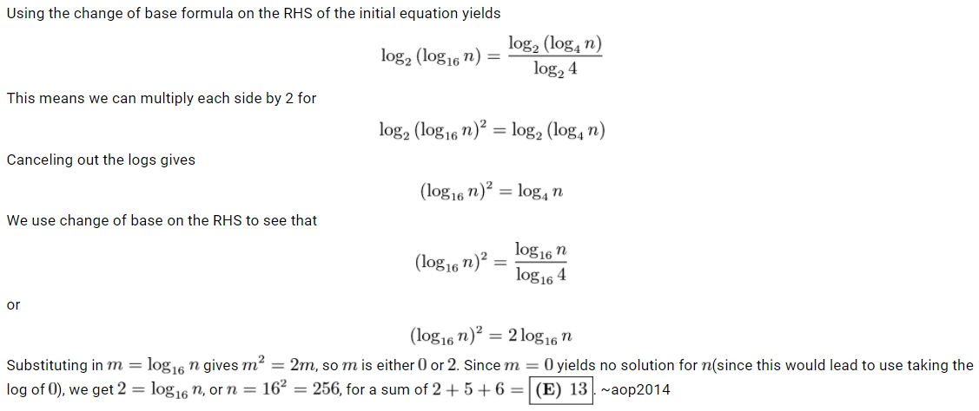

Slide 5


Slide 6



Slide 7



Slide 8



Slide 9
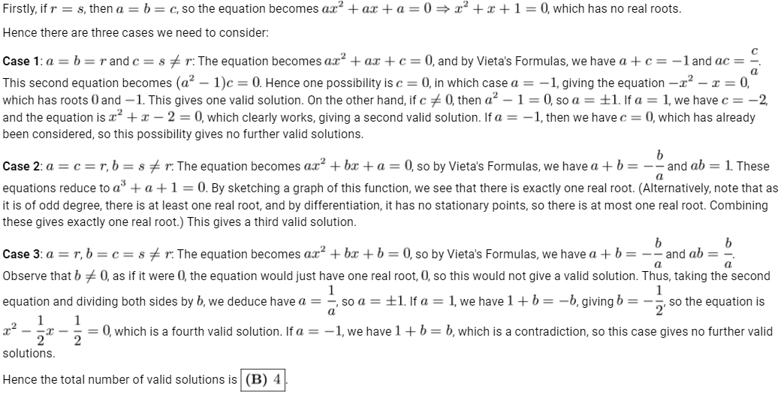

Slide 11



